Slide 1
Breaking free from the confines of the cubicle farm and going out on your own can be one of the most satisfying things you do for your career. It can also be one of the most terrifying. Along with Mike, several consultants and other professionals will help answer the most common questions people ask such as: "How do I get started?", "Where do I find clients?", "How much do I charge?" and many others. Come find out if the grass really is greener on the other side.

Slide 2
Going Independent 101 Lessons Learned from Over a Decade of Independence
Michael Eaton - mjeaton@validussolutions.com - @mjeaton on twitter

Slide 3
Purpose of the Session
Share lessons learned
Provide you with the tools and resources necessary to either:
Support what you’re currently doing as an indie
Make the leap to life as an indie
Notes:
The goal for today is to share lessons learned, to support what you’re doing if you’re already on your own, and finally to empower you to escape the cube farm and become an independent.

Slide 4
Agenda
Lessons Learned from a Decade of Independence
Starting/running a Business
Clients
Rates

Slide 5


Slide 6

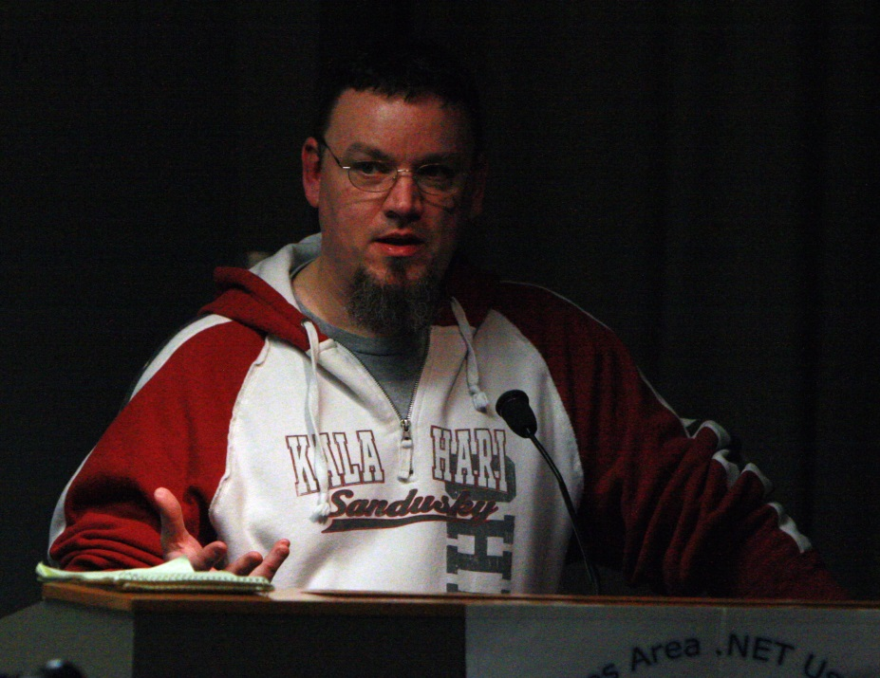
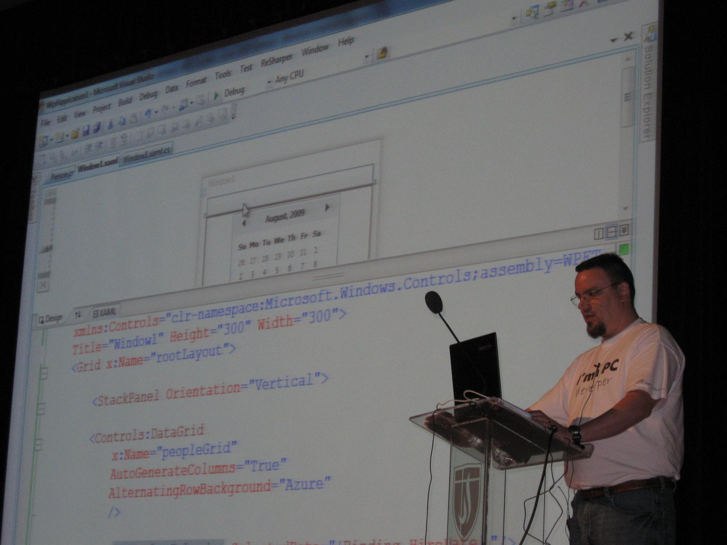
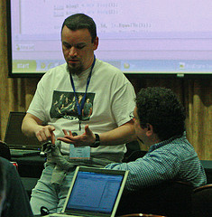



Slide 7

If parts of you don't change after #kalx13, you’re not listening.
"In a time where organizers are censoring speakers and their content, @mjeaton and @kalamazoox is a bastion of freedom. He is a luminary." "@mjeaton @kalamazoox believes in the open exchange of ideas, however uncomfortable, and trusts humans to think, collaborate and create."
"#kalx12 is like an All Star team of speakers. Every single one would have been the best talk at every other conference." "I've discovered @kalamazoox is a hidden gem. Today was like a braver, more profane set of dev-oriented TED talks. Lots of passion and humor."
Other confs are for the head, #kalx13 is for the heart.
#kalx13 part awesome insightful talks, part @mjeaton and friends roasting each other :)

Slide 8
about.me/mjeaton

Slide 9
Disclaimer
I am not a Lawyer
I am not an Accountant
I am not an Insurance Agent
Please consult your Attorney, Accountant or Insurance Agent for specific advice in these areas.

Slide 10
Disclaimer #2
The content of this session is based almost entirely on my own experiences as an independent. Just like with writing code, other independent consultants will have different perspectives on how to run a business and will definitely have different ways of doing things.

Slide 11
How did I get started?
I had no clue what I was doing
I made mistakes
I walked out
I burned bridges
I did EVERYTHING wrong at the beginning
Notes:
How did I get started?

Slide 12
What Have I learned?
Notes:
What have I learned in the past 10 years as an independent?

Slide 13
Be Happy
Notes:
Be happy
Value yourself and your time

Slide 14
Don’t put all your eggs in one basket
Notes:
Don’t put all your eggs in one basket.
Always be looking for what’s next
Be willing to fire clients
Network!
Headhunters
Be wary
Be strong
Cold calling
Never done it, never will

Slide 15
Surround yourself with amazing people
Notes:
Surround yourself with amazing people
Family
Without spousal support, forget it.
Side note about family: if you work from home, there’s a certain amount of training they’ll need to not bug you throughout the day.
Accountant
Attorney
Peer Group
Mastermind Group
My mastermind group is
Alan Stevens
Jamie Wright
Jay Harris
Justin Kohnen

Slide 16
Understand that you’re running a business
Notes:
Understand that you’re running a business
Take it seriously
Reduce friction
Don’t waste your time or your clients’ money
Never work without a contract

Slide 17
It’s about making $$$
Notes:
It’s about making $$$
Things you should NOT do when setting your rate:
Divide your current salary to get an hourly rate
Undervalue yourself
Be afraid
Things you should do
Value yourself
Charge what you think the market can bear

Slide 18
Be willing to make mistakes
Notes:
Be willing to make mistakes
If you’re not making mistakes, you’re not doing it right. ☺

Slide 19
Best and Worst Things
Best
Home since my oldest was 4 months old
Flexible
I am in control
Good money (when times are good)
Worst
Feast/famine
Keeping the pipeline full
Always working
Periods of burnout
Notes:
Best and Worst Things
Best
Home since my oldest was 4 months old
Flexible
I am in control
Good money (when times are good)
Worst
Feast/famine
Keeping the pipeline full
Always working
Periods of burnout

Slide 20
Why do you want to be independent?

Slide 21
In-Depth: Starting and Running a Business

Slide 22
Starting a business is easy, anyone can do it

Slide 23
Business - Planning
Notes:
Have a plan
This doesn’t necessarily mean a full “business plan”
What are your goals?
Certain amount of $$$ per year?
Employees?
Retire at a specific age?
Get out of the cube farm?
Work from home?
How will you meet your goals?

Slide 24
Business - Type
- LLC
- [S | C] Corp
Consult both your accountant *and* your attorney to decide which is best. Do NOT simply take the word of another indie. Each has its pros and cons that should be considered.
Notes:
Business Type
LLC
S-Corp
Consult both your accountant *and* your attorney to decide which is best. Do NOT simply take the word of another indy. Each has its pros and cons that should be considered.

Slide 25
Business - Insurance
General Liability
Errors and Omissions
Professional Liability (malpractice insurance)

Slide 26
Business - Marketing
How will you find clients?
How will you engage the clients you find (or that find you)?

Slide 27
Business - Contracts
Do NOT ever engage in a project without having a contract in place
Do NOT ever engage in a project without having a contract in place
Do NOT ever engage in a project without having a contract in place
Notes:
Contracts
Do NOT ever engage in a project without having a contract in place.
Have a contract drawn up by an attorney familiar with the tech space
If the client provides the contract, have it reviewed by your attorney
Never make any modifications to the contract yourself.
Remember, *you* are not an attorney

Slide 28
Business - Contracts
Have a contract drawn up by an attorney familiar with the tech space
If the client provides the contract, have it reviewed by your attorney
Never make any modifications to the contract yourself.
Remember, *you* are not an attorney
Notes:
Contracts
Do NOT ever engage in a project without having a contract in place.
Have a contract drawn up by an attorney familiar with the tech space
If the client provides the contract, have it reviewed by your attorney
Never make any modifications to the contract yourself.
Remember, *you* are not an attorney

Slide 29
Business - Contracts
Intellectual property ownership
Notes:
Contracts
Do NOT ever engage in a project without having a contract in place.
Have a contract drawn up by an attorney familiar with the tech space
If the client provides the contract, have it reviewed by your attorney
Never make any modifications to the contract yourself.
Remember, *you* are not an attorney

Slide 30
Business - Things to think about
Billing / Invoicing
Track your time!
Make it easy for you
Make it easy for your clients
Think about how you’ll handle slow-pay/no-pay clients *before* it actually happens
It *will* happen, it’s just a matter of time
Net 30 is stupid (rant)
Notes:
Billing / Invoicing
Track your time!
Make it easy for you
Make it easy for your clients
Think about how you’ll handle slow-pay/no-pay clients *before* it actually happens
It *will* happen, it’s just a matter of time
Net 30 is stupid (rant)

Slide 31
Business – Too much work
Employees
Sub-contractors
Notes:
Billing / Invoicing
Track your time!
Make it easy for you
Make it easy for your clients
Think about how you’ll handle slow-pay/no-pay clients *before* it actually happens
It *will* happen, it’s just a matter of time
Net 30 is stupid (rant)

Slide 32
Business – Reduce friction
Harvest
Outright
TimeSnapper
AgileZen
Notes:
Find tools that help
Harvest
Freshbooks
etc

Slide 33
Business - Things to think about
Staying sane
Take time out for you
Unplug once in awhile
Talk to other people outside of IM/IRC/Twitter/Facebook
Notes:
Staying sane
Take time out for you
Unplug once in awhile
Talk to other people outside of IM/IRC/Twitter/Facebook

Slide 34
In-Depth: Clients

Slide 35
Clients - How to find them
Networking!
Contact former bosses and co-workers
Face-to-face networking
Local business groups / Chambers
Headhunters
Business cards
Website / blog
Social networking
Notes:
Clients - How to find them
Networking!
Contact former bosses and co-workers
Face-to-face networking
Local business groups / Chambers
Headhunters
Business cards
Website / blog
Social networking

Slide 36
Clients – After you find them
Do your due diligence
Google them
Search the Better Business Bureau
Ask around
If you see any red flags about the potential relationship, do NOT dismiss them
Notes:
Clients – After you find them
Do your due diligence
Google them
Search the Better Business Bureau
Ask around
If you see any red flags about the potential relationship, do NOT dismiss them without a great deal of thought
Examples
Not wanting to sign a contract
Wanting you to reduce your rate
Extremely short timeframe for the project with few (or no) requirements

Slide 37
Clients – Building the Relationship
Be transparent
Don’t waste your time or their money
Communicate!
Notes:
Clients – Building the Relationship
Once you’ve found a client and decided to work with them
Be transparent
Don’t waste your time or their money
Communicate!

Slide 38
Clients - Communication
Communication is the top priority once you’ve landed the client
Don’t ever hesitate to pick up the phone
Remember, it’s their money and their project
They won’t always be right, but neither will you
Notes:
Clients – Communication
Communication is the top priority once you’ve landed the client
Stand-ups
Daily/Weekly
Keep it simple
What did you do yesterday
What are you doing today
Any roadblocks
Follow-up with email or another call
Don’t ever hesitate to pick up the phone
Remember, it’s their money and their project
They won’t always be right, but neither will you

Slide 39
Clients – When things go bad
Notes:
Clients – When things go bad
There may come a time when things get bad and you’ll need to fire a client
You need to be happy!
Remember, it’s a two-way street
Be respectful (don’t burn the bridge unless it’s necessary)
Make sure there’s a clause in your contract to handle termination by either party

Slide 40
In-Depth: Setting Your Rate

Slide 41
Rates - Calculating
Rate = salary / 2000
Notes:
Rates – Calculating
It’s not as easy as you’d think. While you can simply take your salary and divide it by 1000, you’ll probably want to spend more time figuring out what you actually need to make.
There are several things you need to think about…including:

Slide 42
Rates - Calculating
Rate = salary / 2000
Notes:
Rates – Calculating
It’s not as easy as you’d think. While you can simply take your salary and divide it by 1000, you’ll probably want to spend more time figuring out what you actually need to make.
There are several things you need to think about…including:

Slide 43
Rate – Business Costs
Rent, licenses, travel, phones, marketing, legal fees, accounting fees, hardware, software, insurance, taxes, education, office supplies…
Notes:
What are your business costs? You have to think about everything.
You may have:
Rent
Professional Licenses
Travel
You will have:
Phones
Marketing
Legal Fees
Accounting Fees
Hardware
Software
Insurance
Taxes
Education
Office Supplies
The list goes on…

Slide 44
Rate – Personal Costs
Mortgage, insurance, vehicles, vacation, education, retirement, daily expenses
DO YOU HAVE KIDS? ☺
Notes:
What are your personal costs?
Do you own a house? Do you own a car. Maybe you own a couple houses and a few cars.
Mortgage
Insurance
Vehicle(s)
Vacation
Education
Retirement
Daily Expenses

Slide 45
Rate – Billable Hours
You cannot be 100% billable.
It’s impossible
Did I mention you can’t be 100% billable?
Notes:
How many hours can you bill?
Don’t think you’ll be 100% billable as an indy
Overhead
Marketing
Sales
Invoicing / billing
Collections
Education
Personal time
Vacation(s)
Burn-out

Slide 46
Rate - Profit
Notes:
How much profit do you want to make?

Slide 47
Rate – The Market
Notes:
Can the market bear your rate?

Slide 48
Rate – Skills and Experience
Notes:
Skill and experience?

Slide 49
Rate
Rate = (profit + business costs + personal costs) / (billable hours * billable weeks)

Slide 50
Questions?

Slide 51
Resources
http://www.allbusiness.com
http://freelanceswitch.com
http://webworkerdaily.com
http://harvestapp.com
http://freshbooks.com
http://donxml.com/allthingstechie/archive/2007/02/04/A-Guide-To-Information-Technology-Consulting-Rates.aspx
My Deep Fried Bytes interview on Going Indy
http://tinyurl.com/GoingIndyDFB

Slide 52
Contact Info
Email: mjeaton@validussolutions.com
http://about.me/mjeaton

